Slide 1
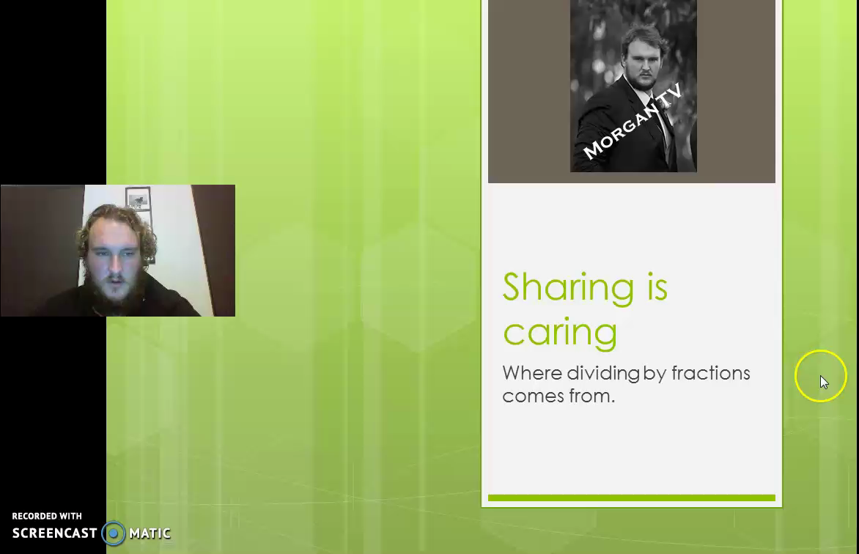
Notes:
A beautifully made video staring me.

Slide 2
Lesson objective
By the end of this lesson you will be able to;
- Divide numbers and fractions by fractions
Notes:
Lesson

Slide 3
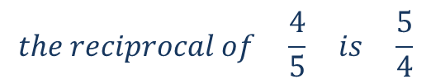
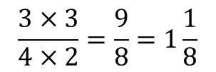
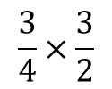

24
7
30
Date
Dividing fractions
EQ – describe how you can divide by fractions?
What is a reciprocal?
The reciprocal of a fraction is basically when a fraction is flipped
$$the reciprocal of \frac{4}{5} is \frac{5}{4}$$
Dividing fractions
Step 1:
Step 2:
Step 3:
Step 4:
Step 1: find the reciprocal of the fraction we are dividing by.
$$\frac{3}{4}÷\frac{2}{3}$$
Step 2: change the fraction we are dividing by to it’s reciprocal and change the sign to multiply
$$\frac{3}{4}×\frac{3}{2}$$
Step 3: Multiply the numerators together and the denominators together Step 4: simplify
$$\frac{3×3}{4×2}=\frac{9}{8}=1\frac{1}{8}$$
5
Notes:
Input

Slide 4
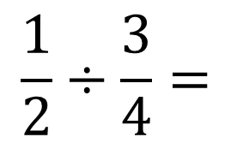
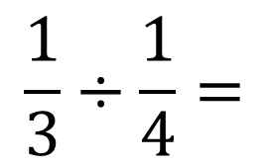
Try these
$$\frac{1}{2}÷\frac{3}{4}=$$
$$\frac{1}{3}÷\frac{1}{4}=$$
Notes:
Check for understanding: allow the students a chance to answer them before working through the solutions

Slide 5
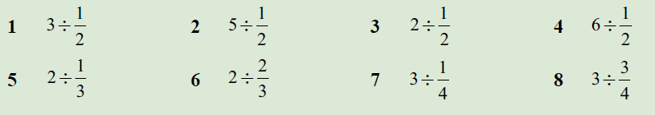
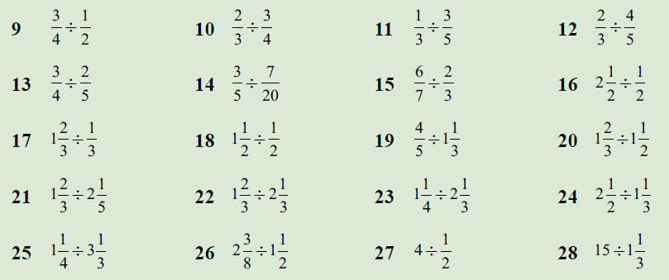
Practice pg78 ex6.6
Notes:
Independent practice

Slide 6

Fraction of the day
Today’s fraction is
$$\frac{8}{10}$$
Notes:
hook

